Slide 1

Image Processing
Introduction to Data, Signal and Image Analysis
Made By -
Jay Ajmera (J004)
Atharva Rode(J056)
Kallind Soni(J065)
Prsni Kanani(J073)

Slide 2
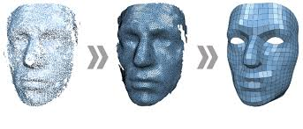
OBJECTIVES
To apply various image processing techniques like blurring , motion blur , sharpening , salt and pepper noise (noise adding) and Denoising (With mean and median).
To improve the image quality , extract information and enhance human perception.

Slide 3
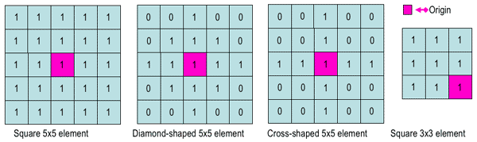
INTRODUCTION
Image processing refers to the use of algorithms and techniques to manipulate digital images. It involves a wide range of operations, including filtering, enhancement, restoration, segmentation, feature extraction, and recognition.
Some common techniques used in image processing include convolution, Fourier transforms, edge detection, and image compression.

Slide 4

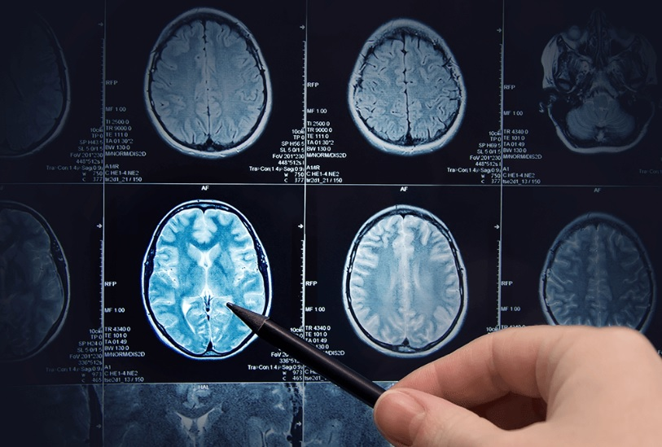
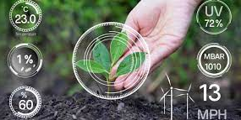

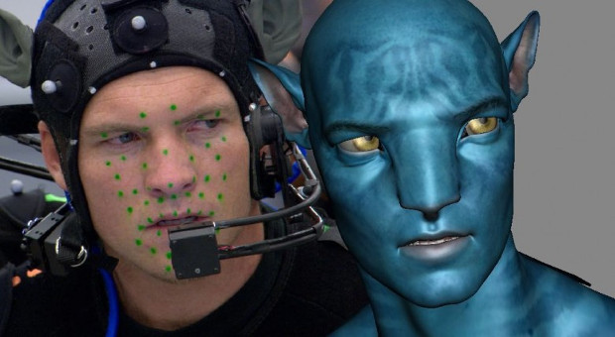
APPLICATIONS
Image processing techniques have a wide range of applications across various fields. Here are a few examples:
Medical Imaging
Robotics
Surveillance and Security
Agriculture
Entertainment

Slide 5
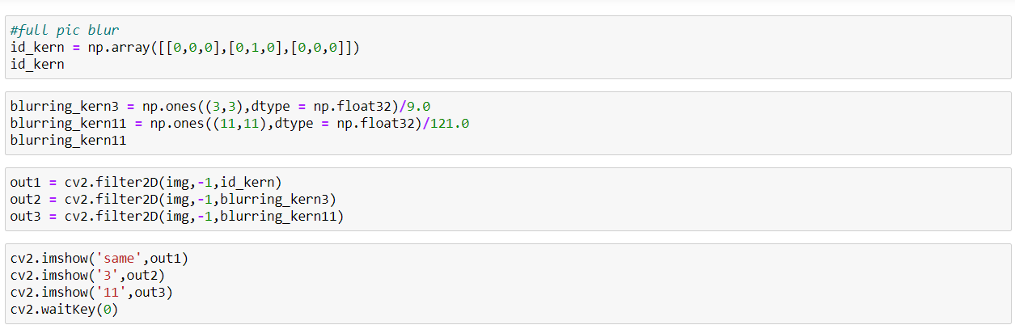
BLURRING
Blurring is a technique in digital image processing in which we perform a convolution operation between the given image and a predefined low-pass filter kernel. The image looks sharper or more detailed if we are able to perceive all the objects and their shapes correctly in it.

Slide 6


BLURRING RESULT
Original image
Blurred image

Slide 7
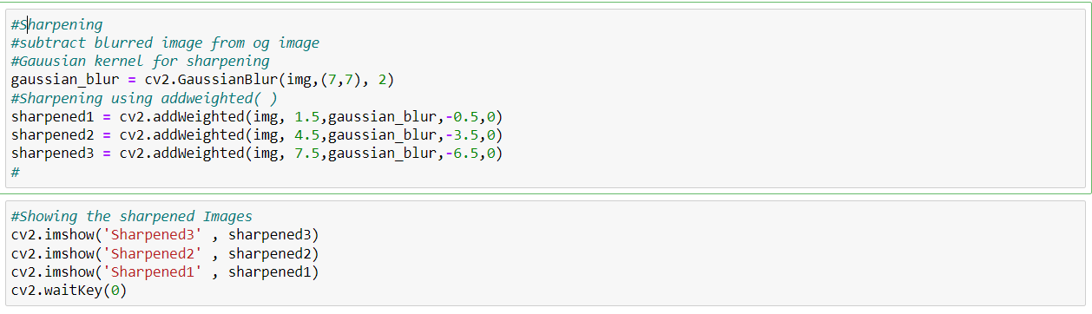
SHARPENING
Image sharpening is an effect applied to digital images to give them a sharper appearance. Sharpening enhances the definition of edges in an image. The dull images are those which are poor at the edges. There is not much difference in background and edges.

Slide 8

SHARPENING RESULT
Original image
Sharpened image

Slide 9
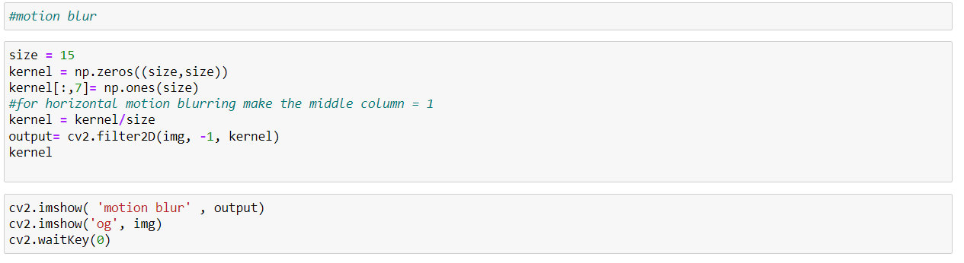
MOTION BLUR
Motion blur is when an object appears blurry because it is moving too quickly for the camera to capture a clear image.
Motion blur is a common form of camera shake which can occur when the shutter speed on your camera is too slow for you to hand hold.

Slide 10

MOTION BLUR RESULT
Original image
Motion Blur image

Slide 11

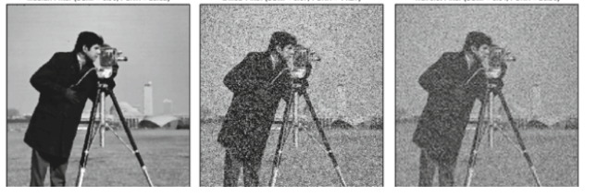
SALT AND PEPPER NOISE
Noise means random disturbance in a signal in a computer version. In our case, the signal is an image.
Random disturbance in the brightness and color of an image is called Image noise. It is found only in grayscale images (black and white image).
As the name suggests salt (white) in pepper (black)–white spots in the dark regions or pepper (black) in salt (white)–black spots in the white regions

Slide 12
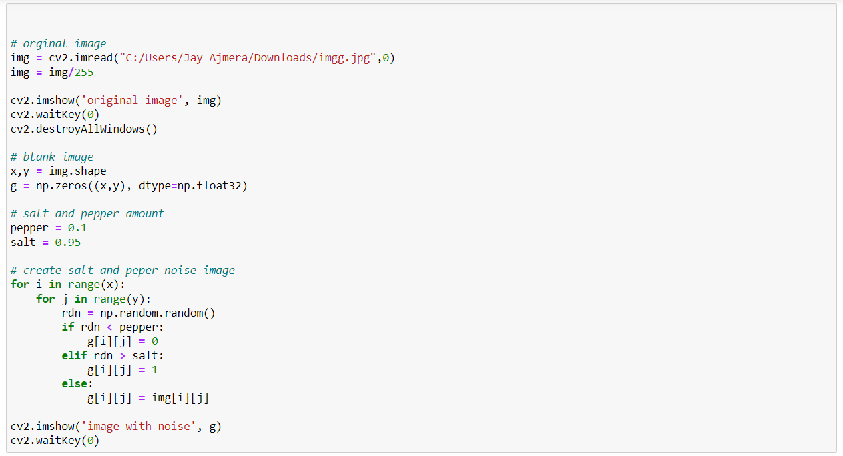
SALT AND PEPPER NOISE

Slide 13

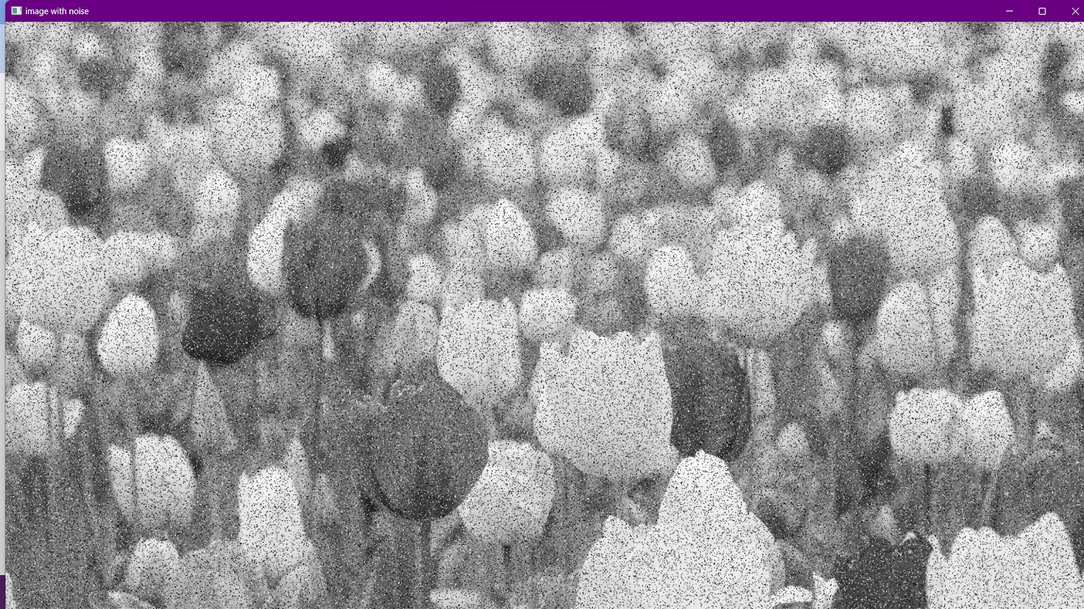
SALT AND PEPPER NOISE RESULT
Original image
Noise image

Slide 14
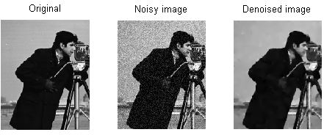
DENOISING
Denoising is a task in image processing and computer vision that aims to remove or reduce noise from an image.
Noise can be introduced into an image due to various reasons, such as camera sensor limitations, lighting conditions, and compression artifacts.
The goal of denoising is to recover the original image, which is considered to be noise-free, from a noisy observation.

Slide 15
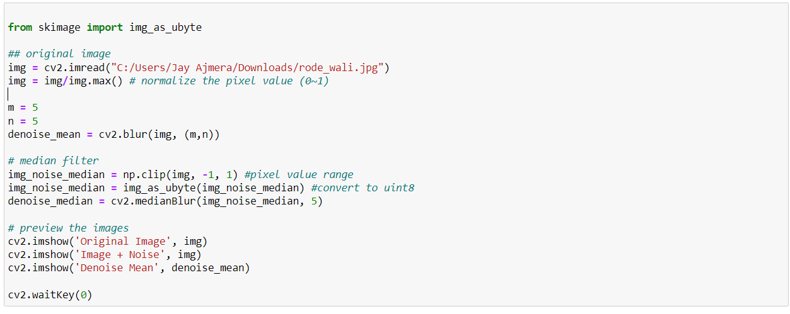
DENOISING (Mean Filter)
The mean filter can be expressed with a convolution product. Indeed, consider the case where the neighborhood is a square of size N X N pixels. The mean filter can be written as a convolution. The noise is reduced by averaging the intensities but the image is blurred.

Slide 16
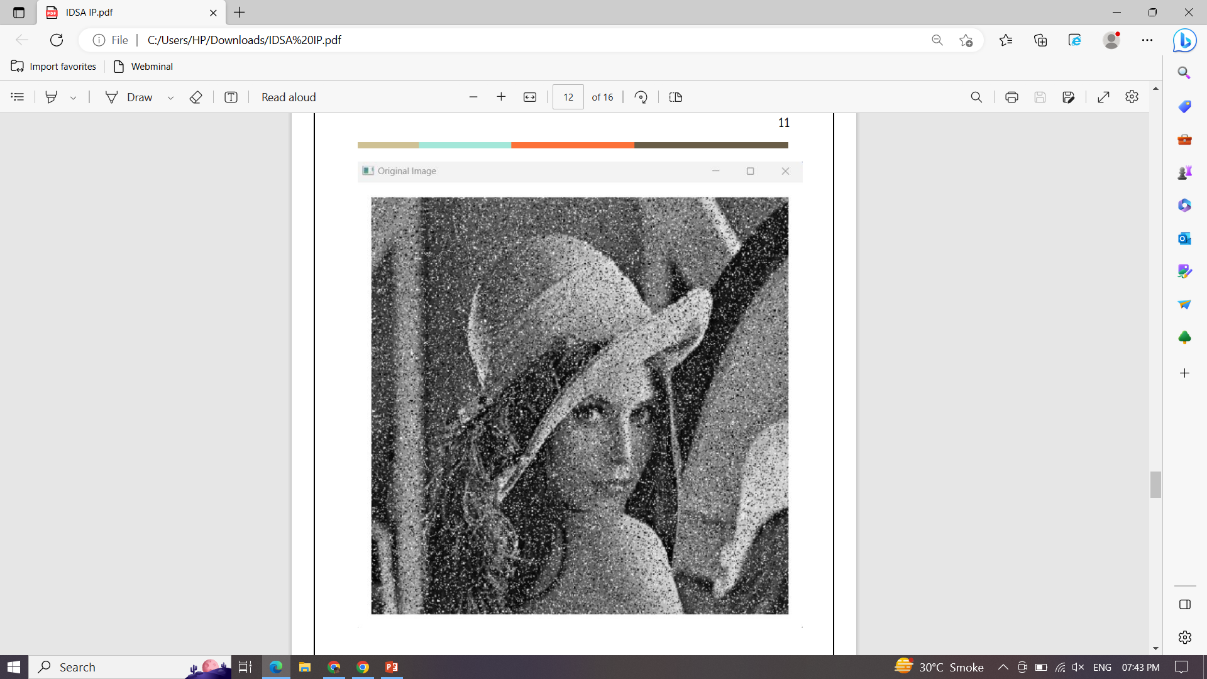
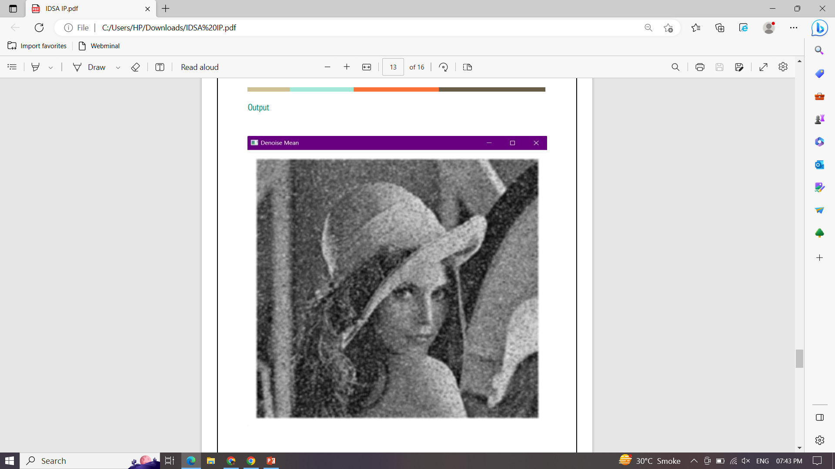
DENOISING (Mean Filter) RESULT
Original image
Denoise mean image

Slide 17
DENOISING (Median Filter)
The median filter is excellent for denoising an image in the case of salt-and-pepper noise because it does not blur the image, as a mean filter would do. Despite its name, the median filter is not a filter because it does not respect the linearity property. Therefore it cannot be written as a convolution

Slide 18
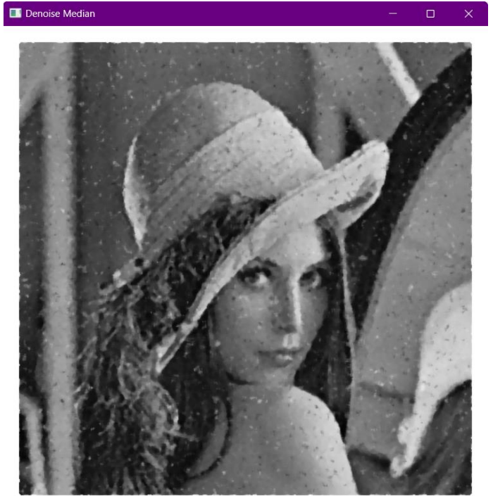
DENOISING (Median Filter) RESULT
Original image
Denoise Median image

Slide 19
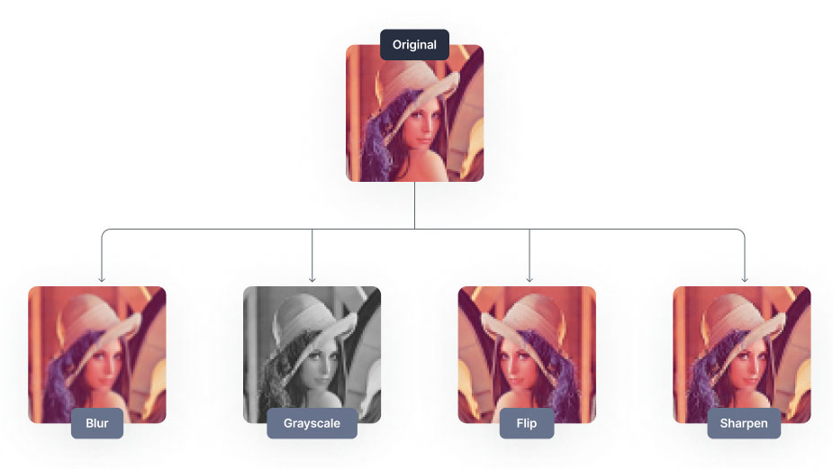
CONCLUSION
In conclusion, image processing plays a vital role in the enhancement and restoration of digital images. The techniques such as blurring, motion blur, sharpening, salt and pepper noise, and denoising are essential for achieving the desired image quality. Blurring and motion blur can be used creatively to produce aesthetically pleasing effects, while sharpening can enhance the image's details and sharpness. On the other hand, salt and pepper noise can negatively impact the image's quality, but denoising can remove the noise and restore the image's clarity.

Slide 20
REFERENCES
https://datacarpentry.org/image-processing/06-blurring/
https://www.analyticsvidhya.com/blog/2021/08/sharpening-an-image-using-opencvlibrary-in-python/
https://www.geeksforgeeks.org/add-a-salt-and-pepper-noise-to-an-image-withpython/amp/
https://medium.com/analytics-vidhya/remove-salt-and-pepper-noise-with-medianfiltering-b739614fe9db
https://www.geeksforgeeks.org/noise-removal-using-median-filter-in-c

Slide 21


